Slide 1
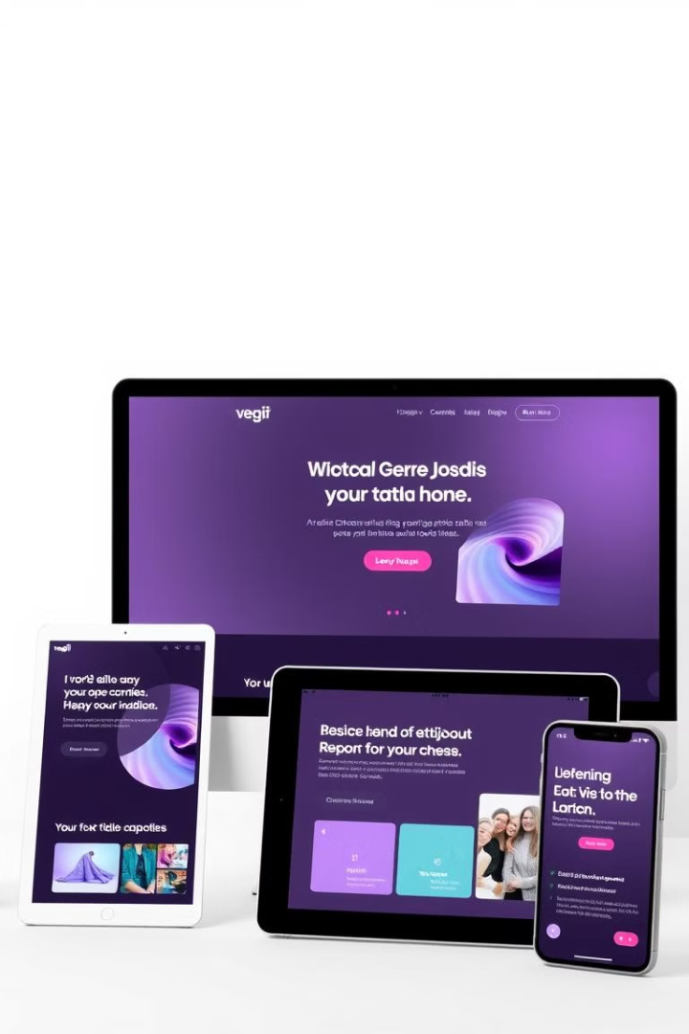


SHANMUGANATHAN ENGINEERING COLLEGE (Accredited by NAAC, an ISO 9001:2015 Certified Institution) ARASAMPATTI – 622 507
DEPARTMENT OF ELECTRONICS AND COMMUNICATION ENGINEERING
Final project:
Developing a Responsive User Interface with React
MR
Presented by,
MEENA R (912421106009)
MOHAMED ABDULLA I (912421106010)

Slide 2

Responsive User Interface
A responsive user interface (UI) is a website or application that displays the same content across devices, but styles it differently based on the screen size and orientation.
The goal is to provide an optimal viewing experience for users across a variety of devices, from mobile phones to desktop computers.

Slide 3
The Importance of Responsive Design
User Satisfaction
Increased Engagement
SEO Benefits
Responsive design ensures users can easily navigate and interact with your website on any device, leading to greater satisfaction.
Users are more likely to spend time on a website that provides a smooth experience on their preferred devices.
Search engines favor responsive websites, improving your ranking and making your content more discoverable.

Slide 4
Fundamentals of Responsive Design
with React
React uses CSS media queries to define different styles for different screen sizes.
React's components enable you to build modular and reusable elements that can adapt to different screen sizes.
React's state management allows you to control the behavior and appearance of your UI elements in response to changes in screen size.

Slide 5
benefits of using the React-Responsive
Easy to work with:
React Responsive library also helps you avoid writing @media rules in your CSS manually and saves you a lot of extra effort. The coding part gets easier to read and understand.
Consistency:
With the React responsive library, you can ensure that designs are consistent for all device screen sizes.
Reusability:
The components of the React-Responsive library can be easily reused in different parts of your website. You don't need to duplicate the code. It allows your designs to be more modular.

Slide 6
Responsive Typography and Scaling of UI Elements
Font Scaling
Adjust font sizes dynamically to maintain readability on different screen sizes.
Element Scaling
Scale images, buttons, and other UI elements proportionally to maintain visual balance.
Responsive Units
Use relative units like percentages and ems to ensure elements adapt to different screen sizes.

Slide 7
Optimizing Images and Media for Responsive Experiences
1
Image Optimization
Use responsive image formats like WebP for smaller file sizes without compromising quality.
2
Srcset and Sizes Attributes
Provide different image sizes for different screen sizes using srcset and sizes attributes.
3
Lazy Loading
Delay loading images until they are visible in the viewport, improving initial page load time.

Slide 8
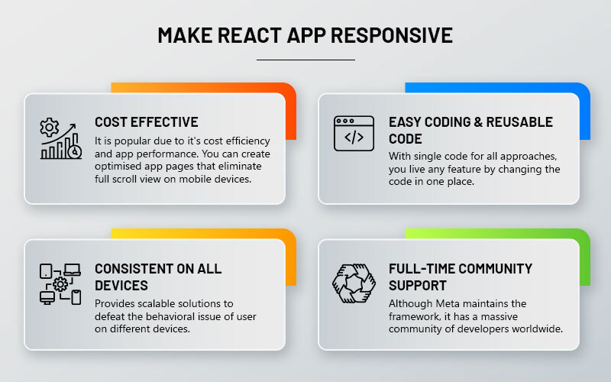
MAKE REACT TO RESPONSIVE

Slide 9
Testing and Debugging Responsive UI in React
Browser Developer Tools
Emulators and Simulators
Use browser developer tools to inspect and debug responsive elements on various screen sizes.
Test your UI on different device emulators and simulators to ensure functionality and visual appeal.
Responsive Testing Frameworks
Utilize responsive testing frameworks like Jest to automatically test your UI across different devices.

Slide 10
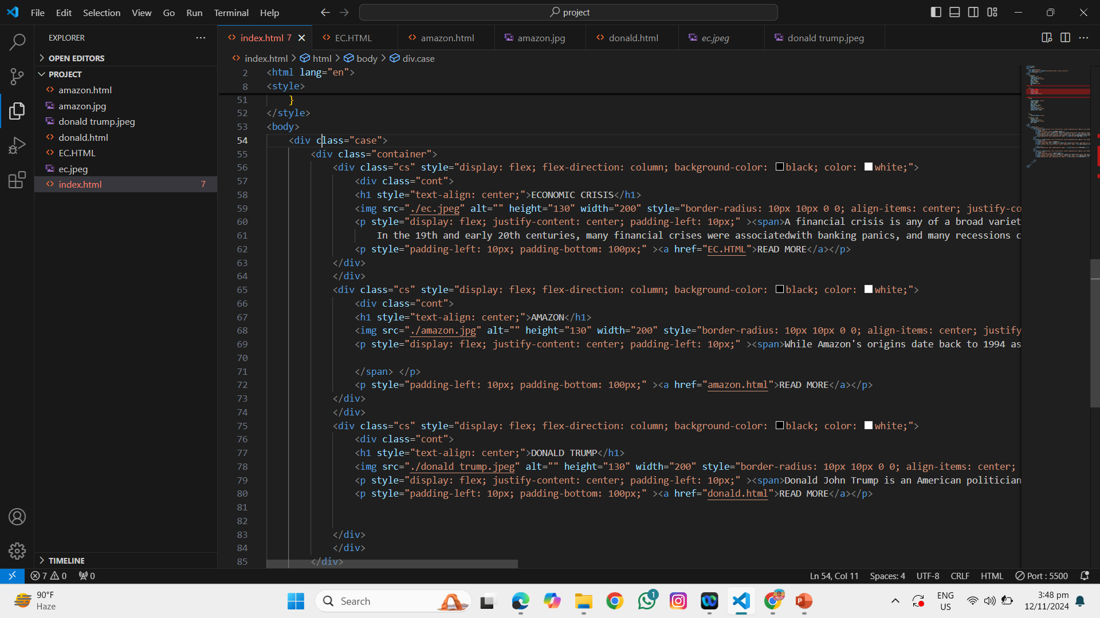
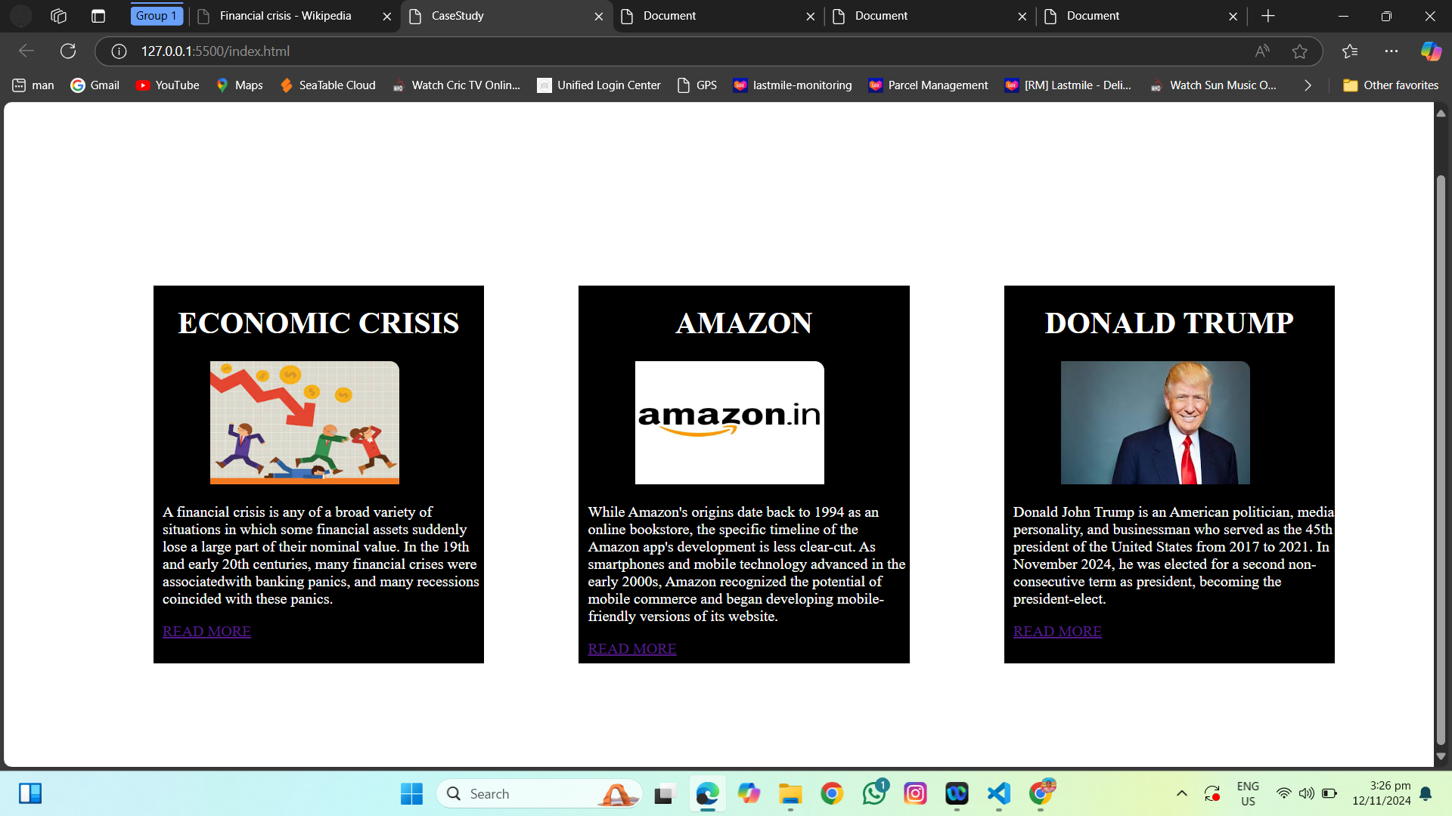
CODE FOR USER INTERFACE: OUTPUT:

Slide 11


